Slide 1
SFRB Applicant Workshop FY2021-22 Funding
Student Fee Review Board
Thursday, August 6th, 1 PM - 2 PM
Wednesday, August 12th, 1 PM - 2 PM

Slide 2
AGENDA
Student Fee Review Board
Introduction to the Board
Unit Eligibility
Application Changes
Funding Considerations
Potential Outcomes
Timeline
Forms
Presenting Your Budget
Communication

Slide 3
Student Fee Review Board
ASUNM MEMBERS
Voting Mia Amin, SFRB Chair Emma Hotz (continuing from FY21 Cycle) Greg Romero (2-year appointment) Ricardo Hill, ASUNM Senator Sall Ryan Ahmadian Non-Voting Kyla Fugate

Slide 4
Student Fee Review Board
GPSA MEMBERS
Voting Naguru Nikhileswara Reddy, SFRB Vice-Chair Bountouraby ‘Raby’ Sylla Non-Voting Victoria Pena-Parr Urusha Thapa

Slide 5
Student Fee Review Board
UNIT ELIGIBILITY
ELIGIBLE
UNM non-academic departments
(programs, organizations, and/or resources centers)
INELIGIBLE
Chartered student organizations that submit appropriation application
(to ASUNM Senate or GPSA Council)
Organizations independent of UNM

Slide 6
Student Fee Review Board
FY 22 Application Changes
- Applicants will not be required to submit paper copies.
- Applications should be submitted via email to sfrb@unm.edu.
- All in-person interactions will be converted to Zoom meetings.
- Zoom links will be available on sfrb.unm.edu at least 72 hours in advance.
*** Due to recent changes, we urge applicants to be mindful of their requested funds and cognizant that units are unlikely to receive an increase in funds from the previous years.

Slide 7
Student Fee Review Board
FY 22 POLICY UPDATES
(No policy updates)

Slide 8
Student Fee Review Board
FUNDING CONSIDERATIONS
Impact on Students:
Potential benefits the entire UNM camps
Applicability to student fees
Advancement of student learning
Unique need on campus
Funding Availability:
Justification of funding increase/decrease
External funding sources
Use of reserves

Slide 9
Student Fee Review Board
POTENTIAL FUNDING OUTCOMES
SFRB provides recommendations to the BLT & UNM Regents
There is no guarantee of funding
The SFRB may direct programs to more appropriate funding sources
The SFRB must consider access and affordability of education in its recommendations.

Slide 10
Student Fee Review Board
TIMELINE
Applications Open | Wednesday, July 29th, 2020
Applications Workshops | Thursday, August 6th, 2020/ 1PM-2PM Wednesday, August 12th, 2020/ 1PM-2PM
Applications Close | Friday, September 11th, 2020/ 5PM
Hearings | Saturday, September 26th, 2020/ 8AM-6PM Sunday, September 27th, 2020/ 8AM-6PM Sunday, October 4th, 2020/ 8AM-6PM
Student Forums | Thursday, October 15th, 2020/ 11AM-1PM Monday, October 19th, 2020/ 11AM-1PM
Deliberations | Saturday, October 24th, 2020/ 8AM-6PM Sunday, October 25th, 2020/ 8AM-6PM Sunday, November 1st, 2020/ 8AM-6PM
Preliminary Recommendations to BLT | Sunday, November 15th, 2020
Tentative Deliberations | TBD
Final Recommendations to BLT | Tuesday, December 1st, 2020

Slide 11
FY22 Funding Funding based on revenue (Total $ Amount) Organizations will receive set amount Funding will not Increase/Decrease with enrollment Vote of Approval Supermajority: 6 of 7
Student Fee Review Board

Slide 12
FY22 Funding
Student Fee Review Board
Applicants must provide documentation on how previous year’s SFRB award was spent

Slide 13
Student Fee Review Board
EXECUTIVE SUMMARY
- No longer than one (1) page
- Introduces your application
- Captures the most important information from your application
- Provides the SFRB with a guide to reading your full application
- Improves transparency to students and other constituents who may review SFRB materials
Examples of Executive Summary are available on sfrb.unm.edu

Slide 14
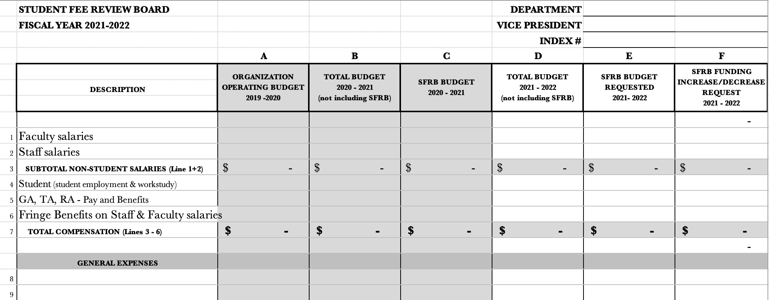
Student Fee Review Board
FORM A

Slide 15
Student Fee Review Board
FORM B AND C
Form B: One-time Funding
If you are requesting one-time funding you must fill out Form B
Form C: External Funding
If you receive external funding you must fill out Form C
Any funding other than student fees

Slide 16
Student Fee Review Board
PRESENTING YOUR BUDGET
Time:
For departments requesting <$350,000 – 15-minute presentation time
For departments requesting >$350,000 – 30-minute presentation time
What to cover:
Overview of organization.
Detailed overview of the use of SFRB funding for the current year.
Detailed overview of the use of SFRB funding for the next fiscal year.
Detailed explanation of any increase in funding request.
** SFRB will have 15 minutes for Q&A after presentations.

Slide 17
Student Fee Review Board
COMMUNICATING WITH SFRB
Website: sfrb.unm.edu
Email: sfrb@unm.edu
SFRB Chair: Mia Amin, asunmprz@unm.edu
SFRB Vice-Chair: Naguru NIKHILeswara Reddy, gpsapres@unm.edu

